Slide 1
THINK 2022

Slide 2
Coverage Monitor

Slide 3
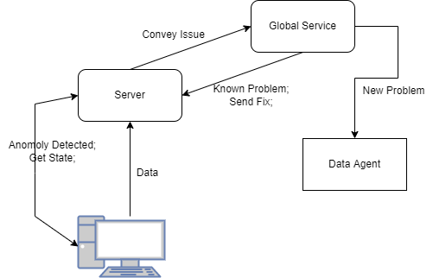
Issues like
missing extension binary
new update not deployed
Can have a dashboards, coverage timeline

Slide 4
Inter Team Sync
After Each Release

Slide 5
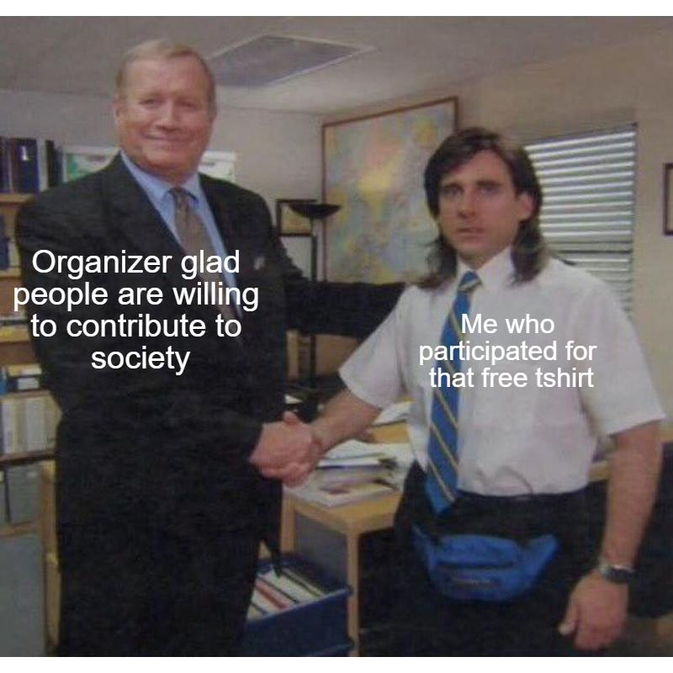
Hackathons !
May the best TEAM win

Slide 6

Bye Windows
Apps

Slide 7
Taglist Generator

Slide 8
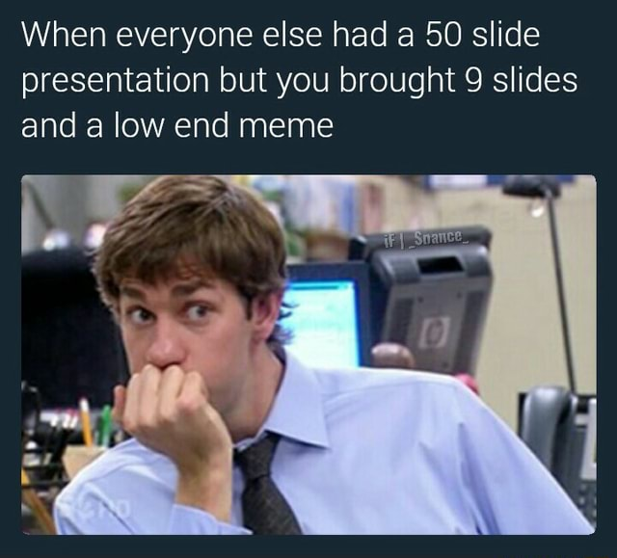
Thanks

